Slide 1
Building Web Application with Ajax

Slide 2
The usual way we operate in the Web
We usually browse some web pages in this sequential manner :
Requesting one page at a time, and have to wait for the server to respond, loading a whole new web page before we continue.
Draw backs:
transmitting information between a client and server generally requires a new page to be loaded.
there are many situations where you load a new page that shares lots of the same parts as the old.
ex: header or “menu bar” of a web page usually don’t change from page to page.

Slide 3
The usual way we operate in the Web (cont.)
JavaScript is one way to cut down on (some of) the client-server response time, by using it to verify form (or other) information before it’s submitted to a server.
Limitation:
there was no way to communicate directly with a web server.

Slide 4
Things change…
AJAX (Asynchronous JavaScript and XML)
is a means of using JavaScript to communicate with a web server without submitting a form or loading a new page.
Client-side programming invokes a bit of server-side programming, but only in a specific area displayed in the user’s browser.

Slide 5
AJAX
AJAX programming typically combines some technology:
client-side JavaScript programming
XML-formatted data transfers
server-side programming via languages such as PHP.
“asynchronous” → the user isn’t left waiting for the server the respond to a request, but can continue using the web page.
AJAX makes use of a built-in object, XMLHttpRequest, to perform this function.

Slide 6
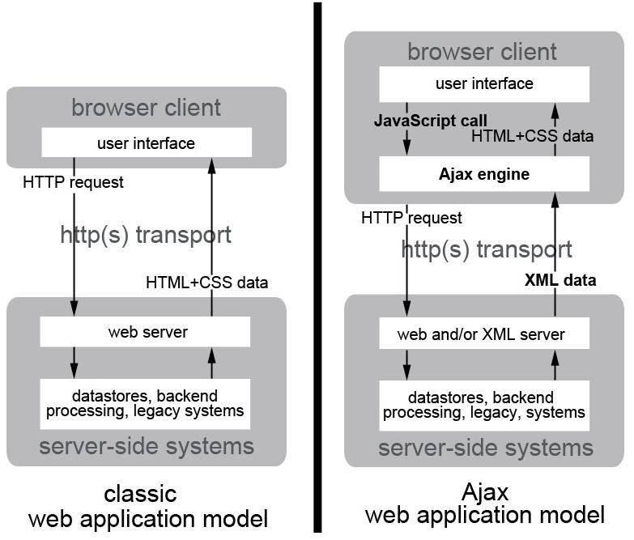

Slide 7
Technology came into play when using Ajax
HTTP Requests and Responses
Client-side programming
Server-side programming
XML
Notes:
HTTP is an Internet standard defining the way web servers and web browsers communicate with each other.
The browser (client) makes an HTTP request when:
a user requests a web page by typing a URL into the address bar of a web browser
following a link
submitting a form
performing any other task that takes the user to a new destination
This request is sent to a web server, which returns one of many possible responses.
Although a DHTML-driven site may show dynamic movement in navigational dropdowns or in form elements that change depending on the selections previously made, all the data for these elements have already been retrieved.
Dynamic HTML, or DHTML, is the term used for the combination of static HTML, CSS, and JavaScript to work with the DOM to alter the appearance of seemingly static web page after all elements have been loaded.
At first glance this functionality seems quite similar to an Ajax-enabled site, and in some ways it is.
The difference lies in the asynchronous connectivity between the client and server—the “A” in Ajax.
Client-side programming occurs within your web browser after a page has been entirely retrieved from a web server.
Common actions performed on the client side include:
showing or hiding sections of text or images,
performing calculations,
and validating user input in a form before sending the form to the server side.
The most common client-side scripting language is JavaScript—the “J” in Ajax.
Server-side programming includes all scripts that reside on a web server and are interpreted or compiled before sending a response to the client.
Server-side programming typically includes server-side connections to databases; requests and responses to and from a database are thus part of the scripts themselves.
These scripts could be written in any server-side language, such as Perl, JSP,ASP, or PHP.
The response of a server-side script is typically displayed as data marked up in some variant of standard HTML.

Slide 8
HTTP Requests and Responses
HTTP is an Internet standard defining the way web servers and web browsers communicate with each other.
The browser (client) makes an HTTP request when:
a user requests a web page by typing a URL into the address bar of a web browser
following a link
submitting a form
performing any other task that takes the user to a new destination
This request is sent to a web server, which returns one of many possible responses.

Slide 9
XML
XML (eXtensible Markup Language) is used in many ways, the most relevant to us being the transfer of structured information.
XML and HTML look similar in many ways and this is because both are based on SGML (Standard Generalized Markup Language).
Like HTML, XML uses tags to denote information but is not limited to the types of tags that occur in HTML.
Tags can be essentially anything a user likes and are used to define the type of data present in the document.

Slide 10
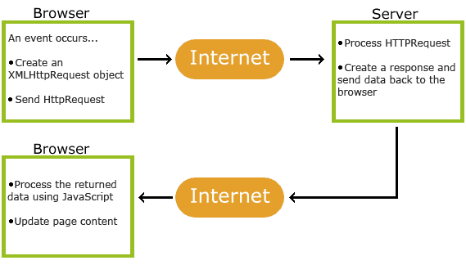
How AJAX Works

Slide 11
How AJAX Works (cont.)
The typical method for using Ajax is the following:
A JavaScript creates an XMLHttpRequest object, initializes it with relevant information as necessary, and sends it to the server. The script (or web page) can continue after sending it to the server.
The server responds by sending the contents of a file or the output of a server side program (written, for example, in PHP).
When the response arrives from the server, a JavaScript function is triggered to act on the data supplied by the server.
This JavaScript response function typically refreshes the display using the DOM, avoiding the requirement to reload or refresh the entire page.

Slide 12
The XMLHttpRequest object
The XMLHttpRequest object is the backbone of every Ajax method. Each application requires the creation of one of these objects.
The XMLHttpRequest object is used to exchange data with a server behind the scenes → it is possible to update parts of a web page, without reloading the whole page.

Slide 13
Create XMLHttpRequest object
Firefox, Safari, Opera, and some other browsers
create one of these objects simply using the “new” keyword.
<script type="text/javascript">
ajaxRequest = new XMLHttpRequest();
</script>

Slide 14
Create XMLHttpRequest object
Microsoft Internet Explorer (IE)
implements this object using its proprietary ActiveX technology (also depend upon the particular version of IE being used).
To handle different types of browsers, we use the
try { . . . } catch (error) { . . . }
To create one of these objects we can use a sequence of try. . . catch blocks, attempting different ways to create an XMLHttpRequest object.

Slide 15
The XMLHttpRequest object (cont.)
function getXMLHTTPRequest() {
var req = false;
try {
/* for Firefox */
req = new XMLHttpRequest();
} catch (err) {
try {
/* for some versions of IE */
req = new ActiveXObject("Msxml2.XMLHTTP");
} catch (err) {
try {
/* for some other versions of IE */
req = new ActiveXObject("Microsoft.XMLHTTP");
} catch (err) {
req = false;
}
}
}
return req;
}

Slide 16
The XMLHttpRequest object (cont.)
The XMLHttpRequest object contains various properties and methods.
The properties are set after the object is created to specify information to be sent to the server, as well as how to handle the response received from the server.
Some properties will be updated to hold status information about whether the request finished successfully.
The methods are used to send the request to the server, and to monitor the progress of the request as it is executed (and to determine if it was completed successfully).

Slide 17
Properties of the XMLHTTPRequest Object
Property | Description
onreadystatechange | Defines a function to be called when the readyState property changes
readyState | Holds the status of the XMLHttpRequest. 0: request not initialized 1: server connection established 2: request received 3: processing request 4: request finished and response is ready
responseText | Returns the response data as a string
responseXML | Returns the response data as XML data
status | Returns the status-number of a request 200: "OK" 403: "Forbidden" 404: "Not Found" For a complete list go to the Http Messages Reference
statusText | Returns the status-text (e.g. "OK" or "Not Found")

Slide 18
We use the readyState to determine when the request has been completed, and then check the status to see if it executed without an error.

Slide 19
Methods of the XMLHTTPRequest Object
Method | Description
new XMLHttpRequest() | Creates a new XMLHttpRequest object
abort() | Cancels the current request
getAllResponseHeaders() | Returns header information
getResponseHeader() | Returns specific header information
open(method,url,async,user,psw) | Specifies the request method: the request type GET or POST url: the file location async: true (asynchronous) or false (synchronous) user: optional user name psw: optional password
send() | Sends the request to the server Used for GET requests
send(string) | Sends the request to the server. Used for POST requests
setRequestHeader() | Adds a label/value pair to the header to be sent

Slide 20
Ajax Request
To send a request to a server, we use the open() and send() methods of the XMLHttpRequest object:
xmlhttp.open("GET","ajax_info.txt",true); xmlhttp.send();
Method | Description
open(method,url,async) | Specifies the type of request, the URL, and if the request should be handled asynchronously or not. method: the type of request: GET or POST url: the location of the file on the server async: true (asynchronous) or false (synchronous)
send(string) | Sends the request off to the server. string: Only used for POST requests

Slide 21
Ajax - GET Requests
GET is simpler and faster than POST, and can be used in most cases.
A simple GET request:
xmlhttp.open("GET", "file.php",true); xmlhttp.send();
In the example above, you may get a cached result.
To avoid this, add a unique ID to the URL:
xmlhttp.open("GET", "file.php?t=" + Math.random(),true); xmlhttp.send();

Slide 22
Ajax - GET Requests (cont.)
If you want to send information with the GET method, add the information to the URL:
xmlhttp.open("GET", "file.php?fname=Henry&lname=Ford",true); xmlhttp.send();

Slide 23
Ajax – POST Request
Use POST requests when:
A cached file is not an option (update a file or database on the server)
Sending a large amount of data to the server (POST has no size limitations)
Sending user input (which can contain unknown characters), POST is more robust and secure than GET

Slide 24
Ajax – POST Request (cont.)
To POST data like an HTML form, add an HTTP header with setRequestHeader().
Specify the data you want to send in the send() method.
An example of a POST request:
xmlhttp.open("POST","ajax_test.asp",true); xmlhttp.setRequestHeader("Content-type","application/x-www-form-urlencoded"); xmlhttp.send("fname=Henry&lname=Ford");

Slide 25
AJAX - Server Response
To get the response from a server, use the responseText or responseXML property of the XMLHttpRequest object.
Property | Description
responseText | get the response data as a string
responseXML | get the response data as XML data

Slide 26
AJAX - Server Response (cont.)
The responseText Property
If the response from the server is not XML, use the responseText property.
The responseText property returns the response as a string, and you can use it accordingly:
Example
document.getElementById("myDiv").innerHTML = xmlhttp.responseText;

Slide 27
The readystate Property
The readyState property holds the status of the XMLHttpRequest.
0: request not initialized
1: server connection established
2: request received
3: processing request
4: request finished and response is ready

Slide 28
The onreadystatechange Event
When a request to a server is sent, we want to perform some actions based on the response.
The onreadystatechange event is triggered every time the readyState changes.
In the onreadystatechange event, we specify what will happen when the server response is ready to be processed.
When readyState is 4 and status is 200, the response is ready.

Slide 29
The onreadystatechange Event (cont.)
xmlhttp.onreadystatechange = function() {
document.getElementById(inner).innerHTML = '<img src="images/ajax_loader.png"/>';
if ((xmlhttp.readyState == 4) && (xmlhttp.status == 200)){
document.getElementById(inner).innerHTML = xmlhttp.responseText;
}
return false;
}

Slide 30
The onreadystatechange Event (cont.)
xmlhttp.onreadystatechange = theHTTPResponse;
function theHTTPResponse() {
document.getElementById('showtime').innerHTML = '<img src="images/ajax_loader.png"/>';
if ((xmlhttp.readyState == 4) && (xmlhttp.status == 200)){
document.getElementById('showtime').innerHTML = xmlhttp.responseText;
}
}

Slide 31
Using a Callback Function
loadDoc("url-1", myFunction1); loadDoc("url-2", myFunction2); function loadDoc(url, cFunction) { var xhttp; xhttp=new XMLHttpRequest(); xhttp.onreadystatechange = function() { if (this.readyState == 4 && this.status == 200) { cFunction(this); } }; xhttp.open("GET", url, true); xhttp.send(); } function myFunction1(xhttp) { // action goes here } function myFunction2(xhttp) { // action goes here }

Slide 32
Example
Simple Ajax
Ajax – GET method
Ajax – POST method
Ajax – Database
Ajax - XML

Slide 33
References
Martin, R., 2013, Comp 519: Web Programming Autumn 2013, University of Liverpool, http://cgi.csc.liv.ac.uk/~martin/teaching/comp519/NOTES/Ajax.ppt, diakses pada 5 Desember 2014.
Ajax Tutorial W3School
(http://www.w3schools.com/ajax/)
Welling, L. and Thomson, L., 2009, PHP and MySQL Web Development Fourth Edition, Pearson Education, Inc.
http://www.quirksmode.org/blog/archives/2005/12/the_ajax_respon.html

